Slide 1
第二章
指令：计算机的语言
“认识从沟通开始”
Notes:
The University of Adelaide, School of Computer Science
Chapter 2 — Instructions: Language of the Computer

Slide 2
指令集
§2.1 Introduction
一个计算机的指令表
不同的计算机架构具有不同的指令集
  大部分都一样
早期计算机的指令集非常简单
  简化实现
许多现代计算机的指令集依然简单
Chapter 2 — Instructions: Language of the Computer — <number>
Notes:
The University of Adelaide, School of Computer Science
Chapter 2 — Instructions: Language of the Computer

Slide 3
The MIPS 指令集
用作贯穿全书的例子
斯坦福大学的MIPS被MIPS科技公司商业化
占有嵌入式芯片市场相当大的份额
  应用于消费类电子产品、网络/存储设备、相机、打印机等
是许多现代ISA的范例
  ARMv7/X86/ARMv8
  实验使用WinMIPS64
  参见图2-1、封2
Chapter 2 — Instructions: Language of the Computer — <number>
Notes:
The University of Adelaide, School of Computer Science
Chapter 2 — Instructions: Language of the Computer

Slide 4
算术运算
加减运算,三个操作数
  两个源操作数和一个目的操作数
add a, b, c # a gets b + c
所有算术运算遵循这一格式
设计原则1：简单源于规整（Simplicity favours regularity）
  规律简化实现
  简单降低高性能的成本。
§2.2 Operations of the Computer Hardware
Chapter 2 — Instructions: Language of the Computer — <number>
Notes:
The University of Adelaide, School of Computer Science
Chapter 2 — Instructions: Language of the Computer

Slide 5
算术示例
例题 C code
f = (g + h) - (i + j);
编译器产生 MIPS code
add t0, g, h # temp t0 = g + h
add t1, i, j # temp t1 = i + j
sub f, t0, t1 # f = t0 - t1
Chapter 2 — Instructions: Language of the Computer — <number>
Notes:
The University of Adelaide, School of Computer Science
Chapter 2 — Instructions: Language of the Computer

Slide 6
寄存器操作
算术运算指令使用寄存器操作数
MIPS 有 32 × 32-bit 寄存器文件
  用于频繁读取的数据
  序号为0-31
  32位的数据称为“word”
汇编器名称为：
  $t0, $t1, …, $t9： 临时变量
  $s0, $s1, …, $s7： 存变量
  $zero, $sp, $fp…
设计原则 2: Smaller is faster
  c.f. 主存: 10⁶的地址
§2.3 Operands of the Computer Hardware
寄存器多
时钟周期长
Chapter 2 — Instructions: Language of the Computer — <number>
Notes:
The University of Adelaide, School of Computer Science
Chapter 2 — Instructions: Language of the Computer

Slide 7
寄存器操作示例
C code:
f = (g + h) - (i + j);
  f, …, j in $s0, …, $s4
编译后的 MIPS code（对比第5页的g/h/i/j）:
add $t0, $s1, $s2
add $t1, $s3, $s4
sub $s0, $t0, $t1
进一步编译 操作数变量-→寄存器变量
Chapter 2 — Instructions: Language of the Computer — <number>
Notes:
The University of Adelaide, School of Computer Science
Chapter 2 — Instructions: Language of the Computer

Slide 8
内存操作数
主存用于组合数据
  数组，结构体，动态数据
应用于算术运算
  从内存往寄存器装载数据
  从寄存器往内存存储数据
内存以byte编址
  每个地址标识一个8-bit字节的空间
字（word）在内存中是对齐的
  地址必须是4的倍数
MIPS 使用大端方式
  指多字节数据的低位保存在内存的高地址中，而数据的高位，保存在内存的低地址中。
  c.f. 小端:是指数据的低位保存在内存的低地址中，而数据的高位保存在内存的高地址中。
Chapter 2 — Instructions: Language of the Computer — <number>
Notes:
The University of Adelaide, School of Computer Science
Chapter 2 — Instructions: Language of the Computer

Slide 9
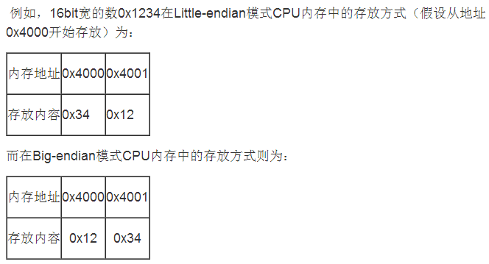
内存操作数
Chapter 2 — Instructions: Language of the Computer — <number>
Notes:
The University of Adelaide, School of Computer Science
Chapter 2 — Instructions: Language of the Computer

Slide 10
内存操作示例1
C code:
g = h + A[8];
  g 存在 $s1, h 存在 $s2, A的基址存在$s3
编译后获得的 MIPS code:
  下标 8 对应字节偏移量 32
    每字4字节
lw $t0, 32($s3) # 加载字
add $s1, $s2, $t0
偏移
地址寄存器
Chapter 2 — Instructions: Language of the Computer — <number>
Notes:
The University of Adelaide, School of Computer Science
Chapter 2 — Instructions: Language of the Computer

Slide 11
内存操作示例2
C code:
A[12] = h + A[8];
  h in $s2, 数组A起始地址在 $s3
编译产生的 MIPS code:
  索引8 的偏移是 32
lw $t0, 32($s3) # 加载字
add $t0, $s2, $t0
sw $t0, 48($s3) # 存储字
Chapter 2 — Instructions: Language of the Computer — <number>
Notes:
The University of Adelaide, School of Computer Science
Chapter 2 — Instructions: Language of the Computer

Slide 12
寄存器 vs.内存
寄存器存取数据比内存快
操作内存数据需要加载和存入两个操作
  需要执行更多指令
编译器需要尽可能多地使用寄存器变量
  仅将不频繁使用的变量存入内存
  寄存器优化非常重要
Chapter 2 — Instructions: Language of the Computer — <number>
Notes:
The University of Adelaide, School of Computer Science
Chapter 2 — Instructions: Language of the Computer

Slide 13
立即操作数
快速加法指令，加立即数指令
指令中指定的常量
addi $s3, $s3, 4
无减立即数指令，改用负数相加表示
  addi $s2, $s1, -1
设计原则 3: 加速大概率事件
  小常量很常见
  立即操作数可少用一次装载指令
Chapter 2 — Instructions: Language of the Computer — <number>
Notes:
The University of Adelaide, School of Computer Science
Chapter 2 — Instructions: Language of the Computer
Make the common case fast

Slide 14
常量0
MIPS 寄存器 0 ($zero) 表示常量0
  不可重写
对大概率操作非常有用
  E.g., 寄存器间传值
  add $t2, $s1, $zero
Chapter 2 — Instructions: Language of the Computer — <number>
Notes:
The University of Adelaide, School of Computer Science
Chapter 2 — Instructions: Language of the Computer

Slide 15
**无符号二进制整数
所有带**的浅灰色标题内容均为系统2内容，已学过，遗忘者请自学。
给一个n位数
§2.4 Signed and Unsigned Numbers
范围: 0 到 +2^{n} – 1
举例
0000 0000 0000 0000 0000 0000 0000 1011₂
= 0 + … + 1×2³ + 0×2² +1×2¹ +1×2⁰
= 0 + … + 8 + 0 + 2 + 1 = 11₁₀
使用32位
  0 to +4,294,967,295
Chapter 2 — Instructions: Language of the Computer — <number>
Notes:
The University of Adelaide, School of Computer Science
Chapter 2 — Instructions: Language of the Computer

Slide 16
**2进制补码有符号整数
给一个n位数
范围: –2^{n – 1} to +2^{n – 1} – 1
举例
1111 1111 1111 1111 1111 1111 1111 1100₂
= –1×2³¹ + 1×2³⁰ + … + 1×2² +0×2¹ +0×2⁰
= –2,147,483,648 + 2,147,483,644 = –4₁₀
使用32位
  –2,147,483,648 to +2,147,483,647
Chapter 2 — Instructions: Language of the Computer — <number>
Notes:
The University of Adelaide, School of Computer Science
Chapter 2 — Instructions: Language of the Computer

Slide 17
**2进制补码有符号整数
第31位是符号位
  1 表示负数
  0 表示非负数
–(–2^{n – 1}) 不能够被表示
非负数具有相同的非负的二进制补码的表示形式。
一些特殊数
  0: 0000 0000 … 0000
  –1: 1111 1111 … 1111
  最大负数: 1000 0000 … 0000
  最大整数: 0111 1111 … 1111
Chapter 2 — Instructions: Language of the Computer — <number>
Notes:
The University of Adelaide, School of Computer Science
Chapter 2 — Instructions: Language of the Computer

Slide 18

**有符号反码
补码和加 1
  补码是表示为 1 → 0, 0 → 1
举例: 反码 +2
  +2 = 0000 0000 … 0010₂
  –2 = 1111 1111 … 1101₂ + 1
  = 1111 1111 … 1110₂
Chapter 2 — Instructions: Language of the Computer — <number>
Notes:
The University of Adelaide, School of Computer Science
Chapter 2 — Instructions: Language of the Computer

Slide 19
**符号扩展
使用更多位来表示一个数字
  数值保持不变
在MIPS指令集中
  addi: 扩展立即数
  lb, lh: 扩展到取字节/半字
  beq, bne: 扩展位移
重复符号位在左边
  c.f. 无符号值：扩展位是0
举例: 8-位 to 16-位
  +2: 0000 0010 => 0000 0000 0000 0010
  –2: 1111 1110 => 1111 1111 1111 1110
Chapter 2 — Instructions: Language of the Computer — <number>
Notes:
The University of Adelaide, School of Computer Science
Chapter 2 — Instructions: Language of the Computer

Slide 20
指令的表示
指令用二进制编码
  称为机器代码
MIPS 指令
  32位 编码指令
  少量格式为操作代码（opcode）、寄存器号等编码
  规整化
  寄存器编号
    $t0 – $t7 映射到 reg’s 8 – 15
    $t8 – $t9 映射到 reg’s 24 – 25
    $s0 – $s7 映射到 reg’s 16 – 23
    其他将在用到时介绍
§2.5 Representing Instructions in the Computer
Chapter 2 — Instructions: Language of the Computer — <number>
Notes:
The University of Adelaide, School of Computer Science
Chapter 2 — Instructions: Language of the Computer

Slide 21
MIPS R-型指令
op
rs
rt
rd
shamt
funct
6 bits
5 bits
5 bits
5 bits
5 bits
6 bits
指令字段
  op: 操作码(opcode)
  rs: 第一个源操作数寄存器编号
  rt: 第二个源操作数寄存器编号
  rd: 目的寄存器编号
  shamt: 移位位数(00000 表示不移位)
  funct: 功能码(扩展操作码)
Chapter 2 — Instructions: Language of the Computer — <number>
Notes:
The University of Adelaide, School of Computer Science
Chapter 2 — Instructions: Language of the Computer

Slide 22
R型指令例子
op
rs
rt
rd
shamt
funct
6 bits
5 bits
5 bits
5 bits
5 bits
6 bits
add $t0, $s1, $s2
special
$s1
$s2
$t0
0
add
pp.53
0
17
18
8
0
32
000000
10001
10010
01000
00000
100000
00000010001100100100000000100000₂ = 02324020₁₆
Chapter 2 — Instructions: Language of the Computer — <number>
Notes:
The University of Adelaide, School of Computer Science
Chapter 2 — Instructions: Language of the Computer

Slide 23
**十六进制
基底是 16
  二进制串的压缩表示（使用16进制的原因）
  四位二进制组成一个16进制数
0 | 0000 | 4 | 0100 | 8 | 1000 | c | 1100
1 | 0001 | 5 | 0101 | 9 | 1001 | d | 1101
2 | 0010 | 6 | 0110 | a | 1010 | e | 1110
3 | 0011 | 7 | 0111 | b | 1011 | f | 1111
Example: eca8 6420
  1110 1100 1010 1000 0110 0100 0010 0000
Chapter 2 — Instructions: Language of the Computer — <number>
Notes:
The University of Adelaide, School of Computer Science
Chapter 2 — Instructions: Language of the Computer

Slide 24
MIPS I-型 指令
对应R型指令的rd/shamt/funct字段
op
rs
rt
constant or address
6 bits
5 bits
5 bits
16 bits
立即数算术和读数/存数指令（操作数地址）
  rt: 目的或源操作数寄存器编号
  常量的取值范围: –215 to +215 – 1
  Address: 偏移加上在rs中的基址
设计原则3: 优秀的设计需要适当的折中方案
  多种指令格式/类型使编码复杂化，但获得统一的32位指令长度
  尽可能保持格式的相似性
寄存器数受限
常数范围受限
Chapter 2 — Instructions: Language of the Computer — <number>
Notes:
The University of Adelaide, School of Computer Science
Chapter 2 — Instructions: Language of the Computer

Slide 25
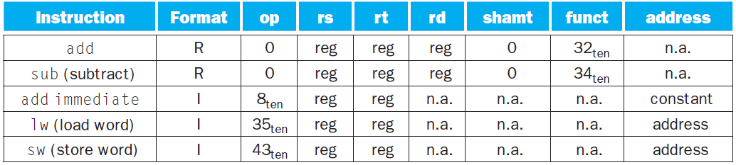
MIPS指令（add/sub/addi/lw/sw）格式汇总-1
Chapter 2 — Instructions: Language of the Computer — <number>
Notes:
The University of Adelaide, School of Computer Science
Chapter 2 — Instructions: Language of the Computer

Slide 26
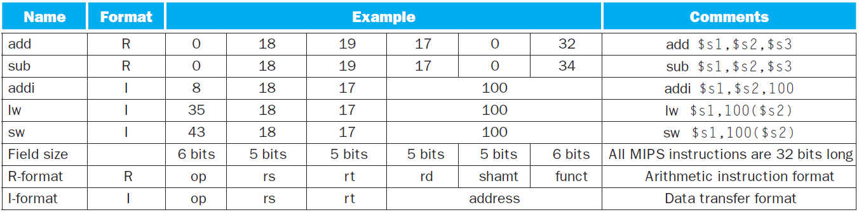
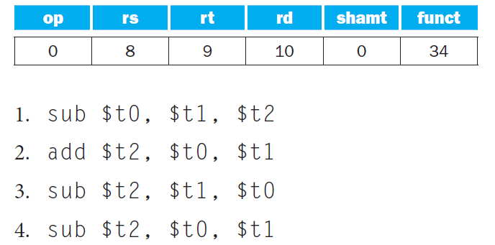
MIPS指令（add/sub/addi/lw/sw）格式汇总（含指令示例）
问题（P 58）：
右边的图表代表的是1-4中的哪条MIPS指令?
Chapter 2 — Instructions: Language of the Computer — <number>
Notes:
The University of Adelaide, School of Computer Science
Chapter 2 — Instructions: Language of the Computer

Slide 27

Stored Program Computers(存储程序概念)
The BIG Picture
指令被表示为二进制，如同数据
指令和数据被存放在内存中
程序能在程序中处理
  e.g., 编译器，链接器, …
二进制通用性允许编译程序在不同的计算平台上运行
  标准化的ISAs
工资
书本文字
Chapter 2 — Instructions: Language of the Computer — <number>
Notes:
The University of Adelaide, School of Computer Science
Chapter 2 — Instructions: Language of the Computer

Slide 28
逻辑操作
对位进行处理的指令
§2.6 Logical Operations
逻辑操作 | C | Java | MIPS
左移 | << | << | sll
右移 | >> | >>> | srl
按位与 | & | & | and, andi
按位或 | | | | | or, ori
按位取反 | ~ | ~ | nor
用于对字中的若干“位”打包和拆包的操作
Chapter 2 — Instructions: Language of the Computer — <number>
Notes:
The University of Adelaide, School of Computer Science
Chapter 2 — Instructions: Language of the Computer

Slide 29
移位操作
op
rs
rt
rd
shamt
funct
6 bits
5 bits
5 bits
5 bits
5 bits
6 bits
shamt: 移多少位
逻辑左移sll
  左移空位填0
  逻辑左移i位相当于乘 2^{i}
逻辑右移srl
  逻辑右移空位填0
  逻辑右移i位相当于除 2^{i} (仅对无符号数)
Chapter 2 — Instructions: Language of the Computer — <number>
Notes:
The University of Adelaide, School of Computer Science
Chapter 2 — Instructions: Language of the Computer

Slide 30
逻辑运算举例
and $t0, $t1, $t2
or $t0, $t1, $t2
nor $t0, $t1, $zero
Chapter 2 — Instructions: Language of the Computer — <number>
Notes:
The University of Adelaide, School of Computer Science
Chapter 2 — Instructions: Language of the Computer

Slide 31
**与操作
可用于一个字中的掩码操作
  Select 选择某些位，其他位清零
and $t0, $t1, $t2
$t2
0000 0000 0000 0000 0000 1101 1100 0000
$t1
0000 0000 0000 0000 0011 1100 0000 0000
$t0
0000 0000 0000 0000 0000 1100 0000 0000
Chapter 2 — Instructions: Language of the Computer — <number>
Notes:
The University of Adelaide, School of Computer Science
Chapter 2 — Instructions: Language of the Computer

Slide 32
**或操作
用于把包含字中的一些位置1，其他不变
or $t0, $t1, $t2
$t2
0000 0000 0000 0000 0000 1101 1100 0000
$t1
0000 0000 0000 0000 0011 1100 0000 0000
$t0
0000 0000 0000 0000 0011 1101 1100 0000
Chapter 2 — Instructions: Language of the Computer — <number>
Notes:
The University of Adelaide, School of Computer Science
Chapter 2 — Instructions: Language of the Computer

Slide 33
**按位取反操作
用于改变字中的一些位
  0 变成 1, 1 变成 0
MIPS 3-操作数指令 NOR
  a NOR b == NOT ( a OR b ) “或非”
nor $t0, $t1, $zero
Register 0: always read as zero
$t1
0000 0000 0000 0000 0011 1100 0000 0000
$t0
1111 1111 1111 1111 1100 0011 1111 1111
Chapter 2 — Instructions: Language of the Computer — <number>
Notes:
The University of Adelaide, School of Computer Science
Chapter 2 — Instructions: Language of the Computer

Slide 34
决策指令
如果条件为真，跳转到被标签的指令执行
  否则，继续执行
beq rs, rt, L1
  if (rs == rt) 转到标签为L1的指令执行;
bne rs, rt, L1
  if (rs != rt)转到标签为L1的指令执行;
j L1
  无条件跳转到标签为L1的指令执行
§2.7 Instructions for Making Decisions
Chapter 2 — Instructions: Language of the Computer — <number>
Notes:
The University of Adelaide, School of Computer Science
Chapter 2 — Instructions: Language of the Computer

Slide 35

编译IF语句
C code:
if (i==j) f = g+h;
else f = g-h;
  f, g, … in $s0, $s1, …
Compiled MIPS code:
bne $s3, $s4, Else
add $s0, $s1, $s2
j Exit
Else: sub $s0, $s1, $s2
Exit: …
Assembler calculates addresses
Chapter 2 — Instructions: Language of the Computer — <number>
Notes:
The University of Adelaide, School of Computer Science
Chapter 2 — Instructions: Language of the Computer

Slide 36
编译循环语句
C code:
while (save[i] == k) i += 1;
  i in $s3, k in $s5, address of save in $s6
Compiled MIPS code:
Loop: sll $t1, $s3, 2
add $t1, $t1, $s6
lw $t0, 0($t1)
bne $t0, $s5, Exit
addi $s3, $s3, 1
j Loop
Exit: …
Chapter 2 — Instructions: Language of the Computer — <number>
Notes:
The University of Adelaide, School of Computer Science
Chapter 2 — Instructions: Language of the Computer

Slide 37
基本块
A 一个基本块就是一个指令序列，其中
  内部没有跳出的指令（结束指令除外）
  也没有被跳转到的指令(开始指令除外）
编译器标识基本块用于优化
高级处理机能够加速基本块的执行
Chapter 2 — Instructions: Language of the Computer — <number>
Notes:
The University of Adelaide, School of Computer Science
Chapter 2 — Instructions: Language of the Computer

Slide 38
更多的条件操作
Set如果条件为真置1，否则置0
slt rd, rs, rt 小于则置位
  if (rs < rt) rd = 1; else rd = 0;
slti rt, rs, constant
  if (rs < constant) rt = 1; else rt = 0;
beq, bne可以和其他指令结合使用
  slt $t0, $s1, $s2 # if ($s1 < $s2)
  bne $t0, $zero, L # branch to L
Chapter 2 — Instructions: Language of the Computer — <number>
Notes:
The University of Adelaide, School of Computer Science
Chapter 2 — Instructions: Language of the Computer

Slide 39
分支指令设计
为什么没有blt, bge, 等指令?
硬件执行<, ≥, … 比 =, ≠慢
  指令中结合分支指令包含更多工作，需要更慢的时钟
  所有的指令都受到影响!
beq and bne 是较常用的
这是一个很好的设计折中方案
Chapter 2 — Instructions: Language of the Computer — <number>
Notes:
The University of Adelaide, School of Computer Science
Chapter 2 — Instructions: Language of the Computer

Slide 40
**有符号数 vs. 无符号数
有符号数比较: slt, slti
无符号数比较: sltu, sltui
Example
  $s0 = 1111 1111 1111 1111 1111 1111 1111 1111
  $s1 = 0000 0000 0000 0000 0000 0000 0000 0001
  slt $t0, $s0, $s1 # signed
    –1 < +1 ⇒ $t0 = 1
  sltu $t0, $s0, $s1 # unsigned
    +4,294,967,295 > +1 ⇒ $t0 = 0
Chapter 2 — Instructions: Language of the Computer — <number>
Notes:
The University of Adelaide, School of Computer Science
Chapter 2 — Instructions: Language of the Computer

Slide 41
过程调用
遵循步骤
  将参数放在过程可以访问的寄存器里
  将控制权转移给过程
  获得过程所需要的存储资源
  执行过程的操作
  P将结果的值放在调用程序可以访问到的寄存器
  将控制权返回到调用点
§2.8 Supporting Procedures in Computer Hardware
Chapter 2 — Instructions: Language of the Computer — <number>
Notes:
The University of Adelaide, School of Computer Science
Chapter 2 — Instructions: Language of the Computer

Slide 42
Register Usage
$a0 – $a3: 传递参数(reg’s 4 – 7)
$v0, $v1: 返回结果值(reg’s 2 and 3)
$t0 – $t9: 临时寄存器
  可以被调用者改写
$s0 – $s7: 保存参数
  必须被调用者保存和恢复
$gp: 静态数据的全局指针寄存器 (reg 28)
$sp: 堆栈指针寄存器(reg 29)
$fp: 帧指针寄存器-保存过程帧的第一个字(reg 30)
$ra: 返回地址寄存器 (reg 31)
Chapter 2 — Instructions: Language of the Computer — <number>
Notes:
The University of Adelaide, School of Computer Science
Chapter 2 — Instructions: Language of the Computer

Slide 43
过程调用指令
过程调用：跳转和链接
jal ProcedureLabel
  下一条指令的地址在寄存器 $ra 中
  跳转到目标地址
过程返回:寄存器跳转
jr $ra
  复制 $ra 到程序计数器
  也可以用于运算后跳转
    e.g., case/switch 语句
Chapter 2 — Instructions: Language of the Computer — <number>
Notes:
The University of Adelaide, School of Computer Science
Chapter 2 — Instructions: Language of the Computer

Slide 44
Leaf Procedure Example
C code:
int leaf_example (int g, h, i, j)
{ int f;
f = (g + h) - (i + j);
return f;
}
  参数 g, …, j 在 $a0, …, $a3中
  f in $s0 (因此, 需要存储$s0 到堆栈)
  结果在$v0
Chapter 2 — Instructions: Language of the Computer — <number>
Notes:
The University of Adelaide, School of Computer Science
Chapter 2 — Instructions: Language of the Computer
S0由“被调用者”负责恢复

Slide 45
非嵌套过程的例子
MIPS code:
leaf_example:
addi $sp, $sp, -4
sw $s0, 0($sp)
add $t0, $a0, $a1
add $t1, $a2, $a3
sub $s0, $t0, $t1
add $v0, $s0, $zero
lw $s0, 0($sp)
addi $sp, $sp, 4
jr $ra
Save $s0 on stack
Procedure body
Result
Restore $s0
Return
Chapter 2 — Instructions: Language of the Computer — <number>
Notes:
The University of Adelaide, School of Computer Science
Chapter 2 — Instructions: Language of the Computer
S0用于f变量，s0由“被调用者”负责恢复

Slide 46
嵌套过程-非叶过程NON-LEAF
过程调用其它过程
对于嵌套调用，调用者需要存储到堆栈的信息：
  它的返回地址
  调用后还需要用的任何参数寄存器和临时寄存器
调用后返回，寄存器会从堆栈中恢复
Chapter 2 — Instructions: Language of the Computer — <number>
Notes:
The University of Adelaide, School of Computer Science
Chapter 2 — Instructions: Language of the Computer

Slide 47
Non-Leaf Procedure Example
C code:
int fact (int n)
{
if (n < 1) return f;
else return n * fact(n - 1);
}
  参数 n 放在 $a0中
  结果放在 $v0
Chapter 2 — Instructions: Language of the Computer — <number>
Notes:
The University of Adelaide, School of Computer Science
Chapter 2 — Instructions: Language of the Computer

Slide 48
Non-Leaf Procedure Example
MIPS code:
fact:
addi $sp, $sp, -8 # adjust stack for 2 items
sw $ra, 4($sp) # save return address
sw $a0, 0($sp) # save argument
slti $t0, $a0, 1 # test for n < 1
beq $t0, $zero, L1
addi $v0, $zero, 1 # if so, result is 1
addi $sp, $sp, 8 # pop 2 items from stack
jr $ra # and return
L1: addi $a0, $a0, -1 # else decrement n
jal fact # recursive call
lw $a0, 0($sp) # restore original n
lw $ra, 4($sp) # and return address
addi $sp, $sp, 8 # pop 2 items from stack
mul $v0, $a0, $v0 # multiply to get result
jr $ra # and return
Chapter 2 — Instructions: Language of the Computer — <number>
Notes:
The University of Adelaide, School of Computer Science
Chapter 2 — Instructions: Language of the Computer
压入堆栈两个参数，一个用于返回地址;一个用于参数n

Slide 49

堆栈中的局部数据
局部数据由调用者分配
  e.g., C 自动分配变量
过程帧(活动记录)
  被一些编译器使用控制堆栈存储
Chapter 2 — Instructions: Language of the Computer — <number>
Notes:
The University of Adelaide, School of Computer Science
Chapter 2 — Instructions: Language of the Computer

Slide 50

Memory Layout内存布局
正文：程序代码
静态数据：全局变量
  e.g., C语言静态变量，常数数组和字符串
  $gp 初始化地址，允许段内的 ±偏移
动态数据：堆
E.g., malloc 函数C, new函数 Java
堆栈：自动存储
Chapter 2 — Instructions: Language of the Computer — <number>
Notes:
The University of Adelaide, School of Computer Science
Chapter 2 — Instructions: Language of the Computer

Slide 51
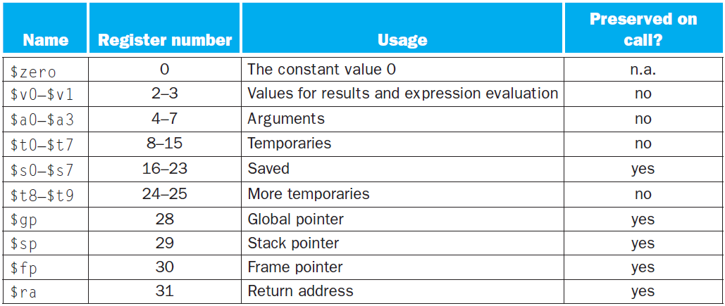
MIPS寄存器约定
Chapter 2 — Instructions: Language of the Computer — <number>
Notes:
The University of Adelaide, School of Computer Science
Chapter 2 — Instructions: Language of the Computer

Slide 52
字符数据
字节编码的字符集
ASCII: 128 个
    95 graphic, 33 control
  Latin-1: 256 个
    ASCII, +96 more graphic characters
Unicode: 32位字符集
  Used in Java, C++ wide characters, …
  宽字符世界上大多数字母表
  UTF-8, UTF-16: 可变长度编码
§2.9 Communicating with People
Chapter 2 — Instructions: Language of the Computer — <number>
Notes:
The University of Adelaide, School of Computer Science
Chapter 2 — Instructions: Language of the Computer

Slide 53
字节/半字操作
使用位操作
MIPS字节/半字 读取/存储
字符串处理是较常用的方式
lb rt, offset(rs) lh rt, offset(rs)
  Sign extend to 32 bits in rt
lbu rt, offset(rs) lhu rt, offset(rs)
  Zero extend to 32 bits in rt
sb rt, offset(rs) sh rt, offset(rs)
  存储恰恰是字节或半子的形式
Chapter 2 — Instructions: Language of the Computer — <number>
Notes:
The University of Adelaide, School of Computer Science
Chapter 2 — Instructions: Language of the Computer

Slide 54
字符串拷贝举例
C code (naïve):
  非终止字符串Null-terminated string
void strcpy (char x[], char y[])
{ int i;
i = 0;
while ((x[i]=y[i])!=‘\0’)
i += 1;
}
  假定x, y 基地址在 $a0, $a1中；
  i 在 $s0 中
Chapter 2 — Instructions: Language of the Computer — <number>
Notes:
The University of Adelaide, School of Computer Science
Chapter 2 — Instructions: Language of the Computer

Slide 55
字符串拷贝
MIPS code:
strcpy:
addi $sp, $sp, -4 # adjust stack for 1 item
sw $s0, 0($sp) # save $s0
add $s0, $zero, $zero # i = 0
L1: add $t1, $s0, $a1 # addr of y[i] in $t1
lbu $t2, 0($t1) # $t2 = y[i]
add $t3, $s0, $a0 # addr of x[i] in $t3
sb $t2, 0($t3) # x[i] = y[i]
beq $t2, $zero, L2 # exit loop if y[i] == 0
addi $s0, $s0, 1 # i = i + 1
j L1 # next iteration of loop
L2: lw $s0, 0($sp) # restore saved $s0
addi $sp, $sp, 4 # pop 1 item from stack
jr $ra # and return
Chapter 2 — Instructions: Language of the Computer — <number>
Notes:
The University of Adelaide, School of Computer Science
Chapter 2 — Instructions: Language of the Computer
假定x, y 基地址在 $a0, $a1中, i 在 $s0 中

Slide 56
32-bit 立即数寻址
大部分常数都比较小，16位表示立即数就足够
lui rt, constant
  取立即数并放到高16位
§2.10 MIPS Addressing for 32-Bit Immediates and Addresses
lhi $s0, 61
0000 0000 0111 1101 0000 0000 0000 0000
ori $s0, $s0, 2304
0000 0000 0111 1101 0000 1001 0000 0000
Chapter 2 — Instructions: Language of the Computer — <number>
Notes:
The University of Adelaide, School of Computer Science
Chapter 2 — Instructions: Language of the Computer
Ori立即数或， $s0与常数2304“或”，结果放在$s0形成一个32位的常数

Slide 57
分支地址
分支指令说明
  操作吗，两个寄存器，两个地址
  大多数跳转目标离跳出的位置较近
  向前或向后
op
rs
rt
constant or address
6 bits
5 bits
5 bits
16 bits
PC相对寻址
  目标地址 = PC + offset × 4
  此时PC的增加量是4的倍数
Chapter 2 — Instructions: Language of the Computer — <number>
Notes:
The University of Adelaide, School of Computer Science
Chapter 2 — Instructions: Language of the Computer

Slide 58
跳转地址
跳转（j和jal）的目标地址可以在代码段的任何位置
  指令除op外，指令其它字段都是地址
op
address
6 bits
26 bits
直接跳转到地址
Target address = PC_{31…28} : (address × 4)
4位
28位
Chapter 2 — Instructions: Language of the Computer — <number>
Notes:
The University of Adelaide, School of Computer Science
Chapter 2 — Instructions: Language of the Computer

Slide 59
目标地址举例
早期例子的循环代码
  设循环的起始地址是8000
Loop: sll $t1, $s3, 2 | 80000 | 0 | 0 | 19 | 9 | 4 | 0
add $t1, $t1, $s6 | 80004 | 0 | 9 | 22 | 9 | 0 | 32
lw $t0, 0($t1) | 80008 | 35 | 9 | 8 | 0
bne $t0, $s5, Exit | 80012 | 5 | 8 | 21 | 2
addi $s3, $s3, 1 | 80016 | 8 | 19 | 19 | 1
j Loop | 80020 | 2 | 20000
Exit: … | 80024
Chapter 2 — Instructions: Language of the Computer — <number>
Notes:
The University of Adelaide, School of Computer Science
Chapter 2 — Instructions: Language of the Computer

Slide 60
远程分支
如果跳转对象地址太大无法用16位的偏移表示，汇编将重写代码
【把短跳转（2¹⁶ 范围）变成长跳转（2²⁶ 范围）】
Example
  beq $s0,$s1, L1
  ↓
  bne $s0,$s1, L2
  j L1
  L2: …
Chapter 2 — Instructions: Language of the Computer — <number>
Notes:
The University of Adelaide, School of Computer Science
Chapter 2 — Instructions: Language of the Computer

Slide 61

地址模式总结
Chapter 2 — Instructions: Language of the Computer — <number>
Notes:
The University of Adelaide, School of Computer Science
Chapter 2 — Instructions: Language of the Computer

Slide 62
并行与指令：同步
处理器共享存储器同一区域
  P1 写, P2 读
（任务1写的结果是任务2要读取得值）如果P1和P2不同步，将发生数据竞争
  结果由访问次序决定
  依赖硬件提供同步指令
  原子读/写内存操作
  在读和写之间，不再允许对该空间的其他操作
  可以是单一的指令
  例如寄存器和内存之间的原子交换
  或者指令的原子配对
§2.11 Parallelism and Instructions: Synchronization
Chapter 2 — Instructions: Language of the Computer — <number>
Notes:
The University of Adelaide, School of Computer Science
Chapter 2 — Instructions: Language of the Computer

Slide 63
MIPS中的同步
链接取数(Load linked)
ll rt, offset(rs)
条件存数(Store conditional)
sc rt, offset(rs)
  如果ll指令没改变该地址内容则成功，rt返回1；
  如果被改变了，则失败，rt返回0；
  例如：atomic swap (检测和设置锁变量)
  try: add $t0,$zero,$s4 ;copy exchange value
  ll $t1,0($s1) ;load linked
  sc $t0,0($s1) ;store conditional
  beq $t0,$zero,try ;branch store fails
  add $s4,$zero,$t1 ;put load value in $s4
Chapter 2 — Instructions: Language of the Computer — <number>
Notes:
The University of Adelaide, School of Computer Science
Chapter 2 — Instructions: Language of the Computer

Slide 64

**Translation and Startup
许多编译器直接产生目标模块
§2.12 Translating and Starting a Program
静态链接
Chapter 2 — Instructions: Language of the Computer — <number>
Notes:
The University of Adelaide, School of Computer Science
Chapter 2 — Instructions: Language of the Computer

Slide 65
汇编伪指令
大多数汇编指令和机器指令是一对一的
特殊的是伪指令
伪指令：汇编指令的变种
move $t0, $t1 → add $t0, $zero, $t1
blt $t0, $t1, L → slt $at, $t0, $t1
bne $at, $zero, L
  $at (register 1): 汇编程序的临时寄存器（使用汇编语言时候的硬件额外的开销
Chapter 2 — Instructions: Language of the Computer — <number>
Notes:
The University of Adelaide, School of Computer Science
Chapter 2 — Instructions: Language of the Computer

Slide 66
**生成目标模块
汇编器（或编译器）把程序翻译成机器语言
提供从部分构建完整程序的信息
  目标文件头：描述目标文件其他部分的大小和位置
  正文段：翻译后的指令，包含机器语言代码
  静态数据段：包含在程序生命周期内分配的数据
  重定位信息，标记了一些程序加载进内存时依赖于绝对地址的指令和数据
  符号表，全局定义和外部引用
  调试信息：用于关联源文件
Chapter 2 — Instructions: Language of the Computer — <number>
Notes:
The University of Adelaide, School of Computer Science
Chapter 2 — Instructions: Language of the Computer

Slide 67
**链接目标模块
产生一个可执行的映像
  1. 合并段（代码和数据数据库象征性放入内存）
  2. 决定数据和指令标签的地址
  3. 修补引用（内部和外部引用）
可以留下依靠重定位程序修复的部分
  但虚拟内存，不需要做这些
  虚拟内存空间，程序必须以绝对地址装入
Chapter 2 — Instructions: Language of the Computer — <number>
Notes:
The University of Adelaide, School of Computer Science
Chapter 2 — Instructions: Language of the Computer

Slide 68
**加载程序
把待执行的程序从硬盘的镜像文件读入内存
  1. 读取可执行文件头来确定正文段和数据段的大小
  2. 为正文和数据创建一个足够大的地址空间
  3. 把指令和初始数据拷贝到内存或者设置页表项,使它们可用
  4. 把主程序的参数复制到栈顶
  5. 初始化寄存器（包括堆栈指针$sp, 帧指针$fp, 全局指针$gp ）
  6. 跳转到启动进程
    复制参数到寄存器并调用主函数main
    主函数返回时，通过系统调用exit终止程序
Chapter 2 — Instructions: Language of the Computer — <number>
Notes:
The University of Adelaide, School of Computer Science
Chapter 2 — Instructions: Language of the Computer

Slide 69
**动态链接库
调用时，只是连接或装入库文件
  过程代码重定位；
  避免所有程序中出现的链接库；但是这些库的信息是一次性代入内存，占用内存空间。只是在用到的时候才链接该库；
  自动装入最新的编译器中的版本的动态库。
Chapter 2 — Instructions: Language of the Computer — <number>
Notes:
The University of Adelaide, School of Computer Science
Chapter 2 — Instructions: Language of the Computer

Slide 70

**晚过程连接
Indirection table
Stub: Loads routine ID,
Jump to linker/loader
Linker/loader code
Dynamically
mapped code
Chapter 2 — Instructions: Language of the Computer — <number>
Notes:
The University of Adelaide, School of Computer Science
Chapter 2 — Instructions: Language of the Computer

Slide 71

**启动一个Java程序
Simple portable instruction set for the JVM
Compiles bytecodes of “hot” methods into native code for host machine
Interprets bytecodes
Chapter 2 — Instructions: Language of the Computer — <number>
Notes:
The University of Adelaide, School of Computer Science
Chapter 2 — Instructions: Language of the Computer

Slide 72
C Sort Example
使用汇编指令的冒泡排序
（交换内存中两个位置所存的值）
Swap procedure (leaf)
  void swap(int v[], int k)
  {
  int temp;
  temp = v[k];
  v[k] = v[k+1];
  v[k+1] = temp;
  }
  v in $a0, k in $a1, temp in $t0
§2.13 A C Sort Example to Put It All Together
Chapter 2 — Instructions: Language of the Computer — <number>
Notes:
The University of Adelaide, School of Computer Science
Chapter 2 — Instructions: Language of the Computer

Slide 73
Swap过程
swap: sll $t1, $a1, 2 # $t1 = k * 4
add $t1, $a0, $t1 # $t1 = v+(k*4)
# (address of v[k])
lw $t0, 0($t1) # $t0 (temp) = v[k]
lw $t2, 4($t1) # $t2 = v[k+1]
sw $t2, 0($t1) # v[k] = $t2 (v[k+1])
sw $t0, 4($t1) # v[k+1] = $t0 (temp)
jr $ra # return to calling routine
Chapter 2 — Instructions: Language of the Computer — <number>
Notes:
The University of Adelaide, School of Computer Science
Chapter 2 — Instructions: Language of the Computer
C代码 （按照字编址） → MIPS代码（按照字节编址）
1、为程序变量分配寄存器； 【v in $a0, k in $a1, temp in $t0】
2、为过程体生成汇编代码；
3、保存过程调用间的寄存器
（本例中没有用到，因为本例是一个叶过程）

Slide 74
C 中排序过程
Non-leaf (calls swap)
  void sort (int v[], int n)
  {
  int i, j;
  for (i = 0; i < n; i += 1) {
  for (j = i – 1;
  j >= 0 && v[j] > v[j + 1];
  j -= 1) {
  swap(v,j);
  }
  }
  }
  v in $a0, k in $a1, i in $s0, j in $s1
Chapter 2 — Instructions: Language of the Computer — <number>
Notes:
The University of Adelaide, School of Computer Science
Chapter 2 — Instructions: Language of the Computer

Slide 75
过程主体
move $s2, $a0 # save $a0 into $s2
move $s3, $a1 # save $a1 into $s3
move $s0, $zero # i = 0
for1tst: slt $t0, $s0, $s3 # $t0 = 0 if $s0 ≥ $s3 (i ≥ n)
beq $t0, $zero, exit1 # go to exit1 if $s0 ≥ $s3 (i ≥ n)
addi $s1, $s0, –1 # j = i – 1
for2tst: slti $t0, $s1, 0 # $t0 = 1 if $s1 < 0 (j < 0)
bne $t0, $zero, exit2 # go to exit2 if $s1 < 0 (j < 0)
sll $t1, $s1, 2 # $t1 = j * 4
add $t2, $s2, $t1 # $t2 = v + (j * 4)
lw $t3, 0($t2) # $t3 = v[j]
lw $t4, 4($t2) # $t4 = v[j + 1]
slt $t0, $t4, $t3 # $t0 = 0 if $t4 ≥ $t3
beq $t0, $zero, exit2 # go to exit2 if $t4 ≥ $t3
move $a0, $s2 # 1st param of swap is v (old $a0)
move $a1, $s1 # 2nd param of swap is j
jal swap # call swap procedure
addi $s1, $s1, –1 # j –= 1
j for2tst # jump to test of inner loop
exit2: addi $s0, $s0, 1 # i += 1
j for1tst # jump to test of outer loop
Move
params
Outer loop
Inner loop
Pass
params
& call
Inner loop
Outer loop
Chapter 2 — Instructions: Language of the Computer — <number>
Notes:
The University of Adelaide, School of Computer Science
Chapter 2 — Instructions: Language of the Computer

Slide 76
完整过程
sort: addi $sp,$sp, –20 # make room on stack for 5 registers
sw $ra, 16($sp) # save $ra on stack
sw $s3,12($sp) # save $s3 on stack
sw $s2, 8($sp) # save $s2 on stack
sw $s1, 4($sp) # save $s1 on stack
sw $s0, 0($sp) # save $s0 on stack
… # procedure body
…
exit1: lw $s0, 0($sp) # restore $s0 from stack
lw $s1, 4($sp) # restore $s1 from stack
lw $s2, 8($sp) # restore $s2 from stack
lw $s3,12($sp) # restore $s3 from stack
lw $ra,16($sp) # restore $ra from stack
addi $sp,$sp, 20 # restore stack pointer
jr $ra # return to calling routine
Chapter 2 — Instructions: Language of the Computer — <number>
Notes:
The University of Adelaide, School of Computer Science
Chapter 2 — Instructions: Language of the Computer

Slide 77




编译优化的影响
1、编译时间
2、指令数；
3、时钟周期
4、CPI
Compiled with gcc for Pentium 4 under Linux
Chapter 2 — Instructions: Language of the Computer — <number>
Notes:
The University of Adelaide, School of Computer Science
Chapter 2 — Instructions: Language of the Computer

Slide 78



Effect of Language and Algorithm
Chapter 2 — Instructions: Language of the Computer — <number>
Notes:
The University of Adelaide, School of Computer Science
Chapter 2 — Instructions: Language of the Computer

Slide 79
经验教训
单独用指令数和CPI不能很好的描述性能
编译器优化对算法敏感
对比 Java虚拟机解释Java/JIT编译代码已经足够快了
  在一些情况下要对编译完C进行优化
没有什么能恢复一个垃圾的算法！
Chapter 2 — Instructions: Language of the Computer — <number>
Notes:
The University of Adelaide, School of Computer Science
Chapter 2 — Instructions: Language of the Computer

Slide 80
**数组和指针
数组下标计算涉及
  元素的下标乘以元素的大小
  加上数组的首地址
指针直接对应于内存地址
  可以避免复杂的索引
§2.14 Arrays versus Pointers
Chapter 2 — Instructions: Language of the Computer — <number>
Notes:
The University of Adelaide, School of Computer Science
Chapter 2 — Instructions: Language of the Computer

Slide 81
**例子:数组和指针实现clearing
clear1(int array[], int size) { int i; for (i = 0; i < size; i += 1) array[i] = 0; } | clear2(int *array, int size) { int *p; for (p = &array[0]; p < &array[size]; p = p + 1) *p = 0; }
move $t0,$zero # i = 0 loop1: sll $t1,$t0,2 # $t1 = i * 4 add $t2,$a0,$t1 # $t2 = # &array[i] sw $zero, 0($t2) # array[i] = 0 addi $t0,$t0,1 # i = i + 1 slt $t3,$t0,$a1 # $t3 = # (i < size) bne $t3,$zero,loop1 # if (…) # goto loop1 | move $t0,$a0 # p = & array[0] sll $t1,$a1,2 # $t1 = size * 4 add $t2,$a0,$t1 # $t2 = # &array[size] loop2: sw $zero,0($t0) # Memory[p] = 0 addi $t0,$t0,4 # p = p + 4 slt $t3,$t0,$t2 # $t3 = #(p<&array[size]) bne $t3,$zero,loop2 # if (…) # goto loop2
Chapter 2 — Instructions: Language of the Computer — <number>
Notes:
The University of Adelaide, School of Computer Science
Chapter 2 — Instructions: Language of the Computer

Slide 82
**数组和指针的比较
乘指令长度的操作变成移位操作
数组需要移到内环
  下标计算用i的自增操作
  相对于而后者 增加指针
编译器可以获得和手动使用指针相同的效果
  引导变量删除
  可以使程序更清晰，更安全
Chapter 2 — Instructions: Language of the Computer — <number>
Notes:
The University of Adelaide, School of Computer Science
Chapter 2 — Instructions: Language of the Computer

Slide 83
**ARM & MIPS Similarities
ARM: 最流行的嵌入式处理机
基本指令集和MIPS类似
§2.16 Real Stuff: ARM Instructions
 | ARM | MIPS
发布时间 | 1985 | 1985
指令大小 | 32 bits | 32 bits
寻址空间 | 32-bit flat | 32-bit flat
数据对齐 | Aligned | Aligned
数据寻址方式 | 9 | 3
寄存器 | 15 × 32-bit | 31 × 32-bit
Input/output | 存储器映射 | 存储器映射
Chapter 2 — Instructions: Language of the Computer — <number>
Notes:
The University of Adelaide, School of Computer Science
Chapter 2 — Instructions: Language of the Computer

Slide 84
**ARM中的比较和分支
使用条件码表示一个算术/逻辑指令的结果
  Negative（负）, zero（零）, carry（进位）, overflow（溢出）
  比较指令，设置条件码不保留结果
每条指令都有一个可选的执行条件
  指令字的高4位：条件值
  可以取代仅为了跳过一条指令的分支指令
Chapter 2 — Instructions: Language of the Computer — <number>
Notes:
The University of Adelaide, School of Computer Science
Chapter 2 — Instructions: Language of the Computer

Slide 85

**指令编码
Chapter 2 — Instructions: Language of the Computer — <number>
Notes:
The University of Adelaide, School of Computer Science
Chapter 2 — Instructions: Language of the Computer

Slide 86
**The Intel x86 ISA指令集
向前兼容的演变过程
  8080 (1974): 8-bit microprocessor
    累加器, 加了3个寄存器组对
  8086 (1978): 16-bit extension to 8080
    复杂指令集(CISC)
  8087 (1980): 浮点协同处理器
    添加了浮点指令寄存器堆栈
  80286 (1982): 24-bit addresses, MMU
    基于段的内存映射和保护
  80386 (1985): 32-bit extension (now IA-32)
    新的寻址方式和额外的操作
    增加了对页的支持并提供了段寻址
§2.17 Real Stuff: x86 Instructions
Chapter 2 — Instructions: Language of the Computer — <number>
Notes:
The University of Adelaide, School of Computer Science
Chapter 2 — Instructions: Language of the Computer

Slide 87
**The Intel x86 ISA
进一步发展
  i486 (1989): pipelined（流水线）, on-chip caches（芯片缓冲） and FPU
    兼容其它品牌: AMD, Cyrix, …
  Pentium (1993): superscalar, 64-bit datapath
    Later versions added MMX (Multi-Media eXtension) instructions
    The infamous FDIV bug 臭名昭著的浮点除法错误
  Pentium Pro (1995), Pentium II (1997)
    New microarchitecture (see Colwell, The Pentium Chronicles)
  Pentium III (1999)
    Added SSE (Streaming SIMD Extensions) and associated registers 关联寄存器
  Pentium 4 (2001)
    New microarchitecture 新微架构
    Added SSE2 instructions
Chapter 2 — Instructions: Language of the Computer — <number>
Notes:
The University of Adelaide, School of Computer Science
Chapter 2 — Instructions: Language of the Computer

Slide 88
**The Intel x86 ISA
更多
  AMD64 (2003): 把体系结构扩展到64位
  EM64T – 扩展内存地址到64位(2004)
    AMD64 adopted by Intel (with refinements)
    增加了 SSE3 指令
  Intel Core (2006)
    增加了SSE4 指令, 支持虚拟机
  AMD64 (announced 2007): SSE5 instructions
    Intel declined to follow, instead…
  Advanced Vector Extension (announced 2008)
    Longer SSE registers, more instructions
如果interl不扩展兼容性，它的竞争者也会。
  技术上的优雅 ≠ 市场成功
Chapter 2 — Instructions: Language of the Computer — <number>
Notes:
The University of Adelaide, School of Computer Science
Chapter 2 — Instructions: Language of the Computer

Slide 89

**Basic x86 寄存器
Chapter 2 — Instructions: Language of the Computer — <number>
Notes:
The University of Adelaide, School of Computer Science
Chapter 2 — Instructions: Language of the Computer

Slide 90
**Basic x86 寻址方式
每条指令2个操作数
Source/dest operand | Second source operand
Register | Register
Register | Immediate
Register | Memory
Memory | Register
Memory | Immediate
内存寻址方式
  Address in register
  Address = R_{base} + displacement
  Address = R_{base} + 2^{scale} × R_{index} (scale = 0, 1, 2, or 3)
  Address = R_{base} + 2^{scale} × R_{index} + displacement
Chapter 2 — Instructions: Language of the Computer — <number>
Notes:
The University of Adelaide, School of Computer Science
Chapter 2 — Instructions: Language of the Computer

Slide 91
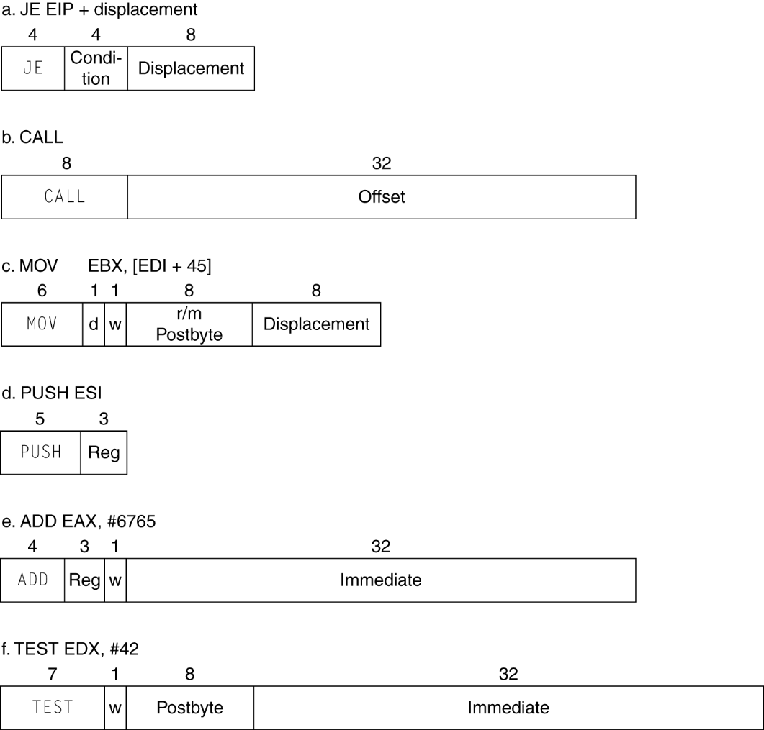
**x86 指令编码
可变长度编码
  后置字节编码
  后置字节修改操作
    操作长度, 重复, 锁定, …
Chapter 2 — Instructions: Language of the Computer — <number>
Notes:
The University of Adelaide, School of Computer Science
Chapter 2 — Instructions: Language of the Computer

Slide 92
**实现 IA-32
复杂指令系统的实现更困难
  硬件翻译指令到简单的微处理机运行
    简单指令：1对1
    复杂指令： 1对多
  微引擎和 RISC相似
  市场份额使其经济可行
与RISC性能比较
  编译器可以避开复杂的指令
Chapter 2 — Instructions: Language of the Computer — <number>
Notes:
The University of Adelaide, School of Computer Science
Chapter 2 — Instructions: Language of the Computer

Slide 93
**ARM v8指令
迁移到64位, ARM做了个完整的检修
ARM v8 类似 MIPS
  从v7来的变化:
    没有条件执行域
    立即数是12位的存储空间
    多个下降加载/存储
    PC 不再是一个GPR
    GPR 集扩展到32
    寻址方式为所有字大小工作
    除法指令
    分支如果等同于/不等同与指令
§2.18 Real Stuff: ARM v8 (64-bit) Instructions
Chapter 2 — Instructions: Language of the Computer — <number>
Notes:
The University of Adelaide, School of Computer Science
Chapter 2 — Instructions: Language of the Computer

Slide 94
谬误
更强大的指令⇒ 更高的性能
  需求更少的指令
  但复杂指令实现困难
    可能带慢了所有的指令, 包括简单指令
  编译器更擅长从简单指令译码
使用汇编程序获得高性能
  但现代编译器更适合现代的处理机
  更多的代码量 ⇒ 更多的错误，更少的产出
§2.19 Fallacies and Pitfalls
Chapter 2 — Instructions: Language of the Computer — <number>
Notes:
The University of Adelaide, School of Computer Science
Chapter 2 — Instructions: Language of the Computer

Slide 95

谬误
向前兼容性 ⇒ 指令集不需改变
  但是他们增加了指令数量
x86 instruction set
Chapter 2 — Instructions: Language of the Computer — <number>
Notes:
The University of Adelaide, School of Computer Science
Chapter 2 — Instructions: Language of the Computer

Slide 96
陷阱
连续字的地址不连续
  增量是4而不是1！
在自动变量的定义过程外，使用指针指向该变量
  例如, 使用一个过程中局部数组的指针，从该过程传出
  堆栈弹出后，指针变为无效
Chapter 2 — Instructions: Language of the Computer — <number>
Notes:
The University of Adelaide, School of Computer Science
Chapter 2 — Instructions: Language of the Computer

Slide 97
本章小结
设计原则
  1. 简单源于规整
  2. 越小越快
  3. 加速指向常用操作
  4. 优秀的设计需要适宜的复用方案
软件和硬件的各个层
  编译器, 汇编器, 硬件
MIPS: 典型的RISC指令集
  相对于x86是CISC指令集
§2.20 Concluding Remarks
Chapter 2 — Instructions: Language of the Computer — <number>
Notes:
The University of Adelaide, School of Computer Science
Chapter 2 — Instructions: Language of the Computer

Slide 98
本章小结
用标准测试程序评测MIPS指令的执行
  考虑加速常用的操作
  考虑折中的方案
指令类 | MIPS 示例 | SPEC2006 整数 | SPEC2006 浮点
Arithmetic | add, sub, addi | 16% | 48%
Data transfer | lw, sw, lb, lbu, lh, lhu, sb, lui | 35% | 36%
Logical | and, or, nor, andi, ori, sll, srl | 12% | 4%
Cond. Branch | beq, bne, slt, slti, sltiu | 34% | 8%
Jump | j, jr, jal | 2% | 0%
Chapter 2 — Instructions: Language of the Computer — <number>
Notes:
The University of Adelaide, School of Computer Science
Chapter 2 — Instructions: Language of the Computer

Slide 99
Why?
“I speak Spanish to God, Italian to women, French to men and German to my horse.”
----------King Charles V
Chapter 2 — Instructions: Language of the Computer — <number>
Notes:
那时候的人们有一个心照不宣的观念：不同的语言显示着社会地位
The University of Adelaide, School of Computer Science
Chapter 2 — Instructions: Language of the Computer

